Slide 1
Design of Software Systems CS 509
Fall 2022
Prof. George Heineman
WPI
heineman@cs.wpi.edu

Slide 2
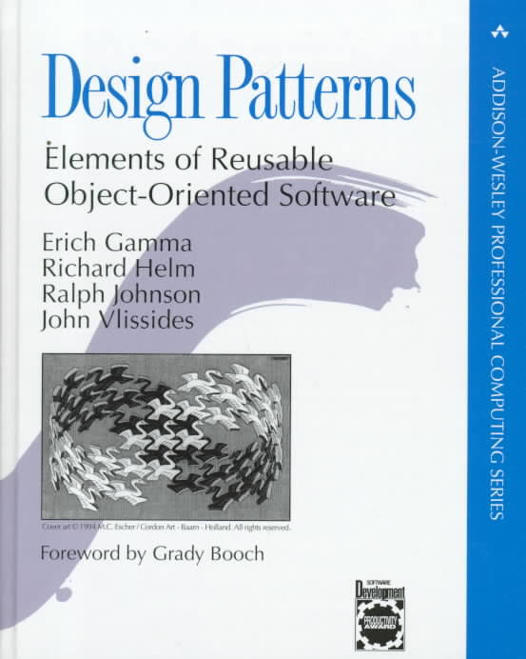
Design Patterns
As long as there are object-oriented languages in use…
Design Patterns will remain as a concept
Best practices
Most elegant solutions
Expected knowledge
Specific solutions to common problems encountered during Object-Oriented design
Rise of design patterns from 1995
Commonly called the “Gang of Four” book
Catalogs 23 common solutions
Each one presented in isolation
I feel best explained “in context”

Slide 3
When to Use Design Patterns
Don’t apply a pattern because you know it exists
Instead, seek to understand the motivation behind each design pattern
Apply the ones that match your situation
Design Problem: Planning For Change
Encapsulate variability
Overarching goal of many class designs
Expected future changes will not modify core code
Repeatedly appears in software
Code that you can “write once” and use without further changes
Non-trivial investments in improved software

Slide 4
When To Use Design Patterns
Design Problem: Runtime Flexibility
Prefer Delegation to Inheritance
More flexible class structures
Supports runtime configuration to change behavior without requiring recompilation
JavaScript changes the landscape
Every OO language has its own way of considering design patterns
https://www.dofactory.com/javascript/design-patterns
Java has more traditional needs:
https://github.com/heineman/tangram
See Canvas | Files | Tangram for powerpoint slides on Java-based DPs

Slide 5
Creational Design Patterns
Create objects rather than having programmer instantiate objects directly using new
Abstract Factory Group object factories that have a common theme
Builder Construct complex objects by separating construction and representation
Factory Method Create objects without specifying the exact class to create
Prototype Create objects by cloning an existing object
Singleton Restrict object creation for a class to only one instance

Slide 6
Structural Design Patterns
Use inheritance to compose interfaces and objects to obtain new functionality
Adapter Allow classes with incompatible interfaces to work together
Bridge Decouple abstraction from implementation to vary both independently
Composite Compose similar objects so they can be manipulated as one object
Decorator Dynamically add/override behavior in an existing method of an object
Façade Provide a simplified interface to a large body of code
Flyweight Reduce cost of creating and manipulating a number of similar objects
Proxy Provide placeholder for another object to control access

Slide 7
Behavioral Design Patterns
Concerned with communication between objects
Chain of Responsibility Delegate commands to a chain of processing objects
Command Create objects which encapsulate actions and parameters
Interpreter Implement a specialized language
Iterator Access elements of object without exposing underlying representation
Mediator Allow loose coupling between classes
Memento Provide the ability to restore an object to its previous state
Observer A publish/subscribe pattern to broadcast events
State Allow an object to alter its behavior when its internal state changes
Strategy Allows one of a family of algorithms to be selected on-the-fly at runtime
Template Method Allow subclasses to provide behavior from skeleton
Visitor Separate algorithm from object structure

Slide 8
Design Pattern Template
Name
Identifies pattern
Intent and Motivation
Describe situations where pattern can be used
Solution
Collaborating classes and interfaces
Consequences
Resulting from the choice of pattern

Slide 9
Iterator Design Pattern
Intent
Provide access to elements in aggregate object without exposing underlying representation
Motivation
Change in internal representation often means external interface must change in response
Clients should be shielded from changes

Slide 10
Design Pattern Template
Name
Identifies pattern
Intent and Motivation
Describe situations where pattern can be used
Solution
Collaborating classes and interfaces
Consequences
Resulting from the choice of pattern

Slide 11
Iterator Design Pattern
Intent
Provide access to elements in aggregate object without exposing underlying representation
Motivation
Change in internal representation often means external interface must change in response
Clients should be shielded from changes
Solution
Prevent access to items directly
class Iterator {
constructor(items) {
this.items = items;
this.index = 0;
}
hasNext() { return this.index < this.items.length; }
next() { return this.items[this.index++]; }
each(callback) {
while (this.hasNext()) {
callback(this.next());
}
}
}

Slide 12
Analysis Approach
Need to support multi-level undo of actions
What if you wanted to support undo of an extend color?
Support multi-level redo
GUI changes
Easy to add some form of interaction to request action (Ctrl-Z, Ctrl-Y)
Controllers know how to carry out actions
But who should handle the undo? Or redo?
Instead of showing a sub-optimal solution, we turn to the Command design pattern

Slide 13
Command Design Pattern
Intent
Encapsulate a request as an object
Decouple request from its execution
Motivation
Easily supports undo/redo since Command subclass contains all state to execute and reverse action

Slide 14
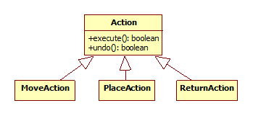
Command Design Pattern
Solution
Action defines interface
Subclasses contain actual logic
Controllers instantiate action objects and call execute()
Undo/Redo
Supported by move and redo Stacks

Slide 15
Design Approach
Model
Use moveStack and redoStack to store actions
When action is executed, push onto moveStack
Helper methods maintain state
Be careful of re-executing an action that had previously been undone
Place capability in the Model class, which provides a useful location for accessing any and all entity objects

Slide 16
UndoController
Retrieve last Action and undo it
Redo is similar but it
uses removeRedoAction and it recordsRedoneAction
on success
process() {
let action = model.removeLastAction();
if (! action) { return false; }
if (action.undo()) {
model.recordRedoableAction(action);
return true;
}
return false; // didn’t undo
}

Slide 17
Action Approach
Each Action subclass needs full state to be able to restore to prior state
MoveAction must cover every possible piece of information needed to redo
And as moves become more complicated, this becomes untenable

Slide 18
Memento Design Pattern
Intent
Without violating encapsulation, externalize an object’s internal state
Motivation
Want to restore an object to its prior state, but don’t want to force programmer to use complicated, ad hoc interface to carry this out

Slide 19
Memento Design Pattern
Solution
Use PuzzleMemento to capture the state
Original object can restore state from memento (example…)
Consequence
As state becomes more and more complicated, this approach is more and more appealing
class Person {
constructor(name, street, city, state) {
this.name = name;
this.street = street;
this.city = city;
this.state = state;
}
restore(memento) {
var m = JSON.parse(memento);
this.name = m.name;
this.street = m.street;
this.city = m.city;
this.state = m.state;
}
externalize() {
var memento = JSON.stringify(this);
return memento;
}
}

Slide 20
Observer Design Pattern
Intent
Define a 1-to-many dependency between objects
When one object changes state, all dependents are notified and updated automatically
Motivation
Maintain separation between dependent objects so each one can vary independently

Slide 21
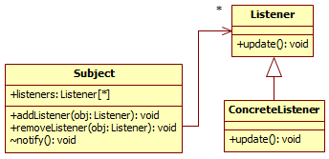
Observer Design Pattern
Solution
Subject class maintains a number of Listeners
Listeners registered with Subject
Consequence
Broadcast behavior
ConcreteListener does all the work

Slide 22
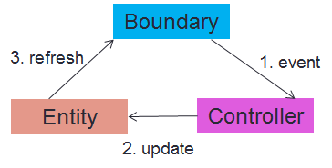
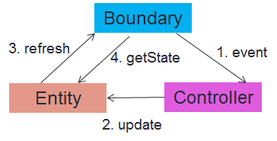
Observer Design Pattern
Alert all registered listeners when state changes
Multiple ways to proceed. React has its own style
Push Observer
Pull Observer
function App() {
// initial instantiation of the Model
const [model, setModel] = React.useState(new Model(actualPuzzle));
Whenever you call setModel on the app, it requests app to refresh, which “pulls” data from the model to be rendered
<label data-testid="moves-label" style={layout.text}>{"number moves: " + model.numMoves}</label>

Slide 23
Singleton Design Pattern
Intent
When you only need a single instance of a class
Motivation
Separate construction of object from its retrieval
Solution
Anonymous Immediate Function
// an immediate anonymnous function
(function(Singleton) {
var instance;
function createInstance() {
var object = new Object("I am the instance");
return object;
}
function getInstance() {
if (!instance) { instance = createInstance(); }
return instance;
}
Singleton.getInstance = getInstance;
}) (typeof Singleton === 'undefined’ ? this['Singleton']={}: Singleton);

Slide 24
Problems with Singleton Objects
Not thread-safe
First code that calls getInstance wins
Hard to instantiate with parameters
// SINGLETON
let instance1 = Singleton.getInstance();
let instance2 = Singleton.getInstance();
console.log("Same instance? " + (instance1 === instance2));

Slide 25
Group.Analysis Discussion
Calculator AWS tutorial
Currently only shows “ADD” and “EQUALS” requests
Provide added capabilities
Show a list of constants on the client browser that are available
Enable new constants to be created
Enable existing ones to be deleted
In my examples so far, I have shown how Javascript can manipulate existing elements
But you can create/add arbitrary new HTML

Slide 26
Show Constants List
Payload: GET /constants
No Javascript can be sent on GET requests
Response:
{ “constants” : [ { “name” : “e”, “value” : “2.71828” }, { “name” : “pi”, “value” : “3.141592”} ] }

Slide 27
Manipulate a <div id=“constantList”>
function processListResponse(result) {
var js = JSON.parse(result);
var constList = document.getElementById('constantList');
var output = "";
for (var i = 0; i < js.list.length; i++) {
var constantJson = js.list[i];
var cname = constantJson["name"];
var cval = constantJson["value"];
output = output + “<b>" + cname + ":</b> = " + cval + "(<a href='javaScript:requestDelete(\"" + cname + "\")'> <img src='deleteIcon.png'></img></a>) <br>";
}
// Update computation result
constList.innerHTML = output;
}

Slide 28
Delete a Constant
Payload: POST /delete_constant
{ “name” : “e” }
Response-1:
{ “constants” : [ { “name” : “pi”, “value” : “3.141592”} ] }
Response-2:
{ “action” : “delete_constant”, “name” : “e”, “success”: “True” }

Slide 29
Before After StoryBoards: DELETE
BEFORE
AFTER
{ “name” : “e” }
{ “constants” : [ { “name” : “pi”, “value” : “3.141592” } ] }

Slide 30
Before After StoryBoards: CREATE
BEFORE
AFTER
{ “name” : “e” }
{ “constants” : [{ “name” : “e”, “value” : “2.71828” }, { “name” : “pi”, “value” : “3.141592” } ] }

Slide 31
Before After StoryBoards: ADD
BEFORE
AFTER
{ “arg1” : “3”, “arg2”: “e” }
{ “result” : “5.71828”}

